Slide 1
ASD Final Project Ether Group #2 Professor Payman salek
Members
Peter James Bernante
Thanh Tri Nguyen
Hong Gu
Gong Ma
Mustafa Mohammadi
Phuong

Slide 2

Outline
Project Overview
Achievements
Design Patterns Used
System Design and Diagrams
Demo

Slide 3

Project Overview
Final Project to implement some sort of design patterns we learned
Develop a Framework that could be used for Banking and Credit System
Common Requirements and features
Make Code Reuse
Implement Design Principles
Reduce Maintenance Nightmare
.

Slide 4

Achievements
A well designed Framework for
Credit-Card System
Banking System
Simple Credit Card and Banking Application
To Test How Framework is as supposed

Slide 5

Design Patterns Used
Command
Abstract Factory
Strategy
Proxy
Visitor
Template
Observer
Singleton

Slide 6
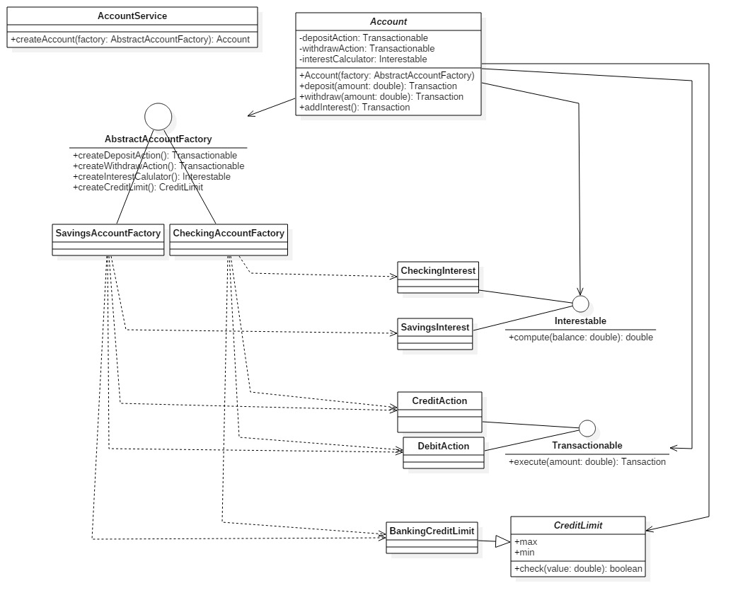
Design – Account Class

Slide 7
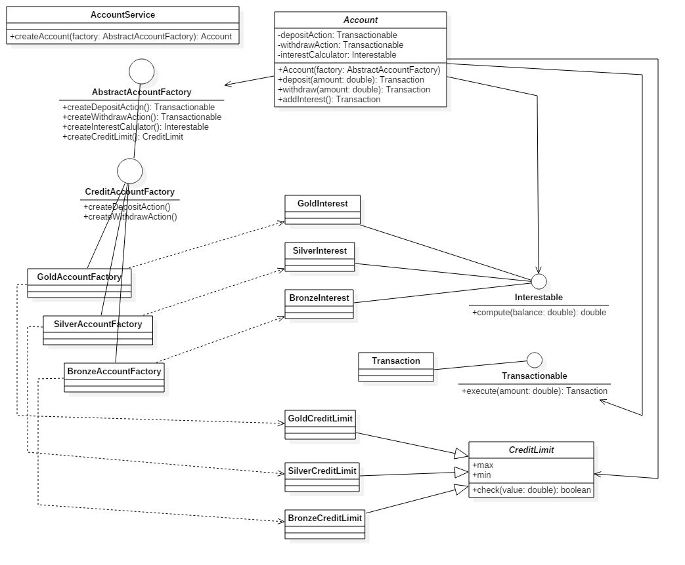
Design – Credit Abstract factory

Slide 8
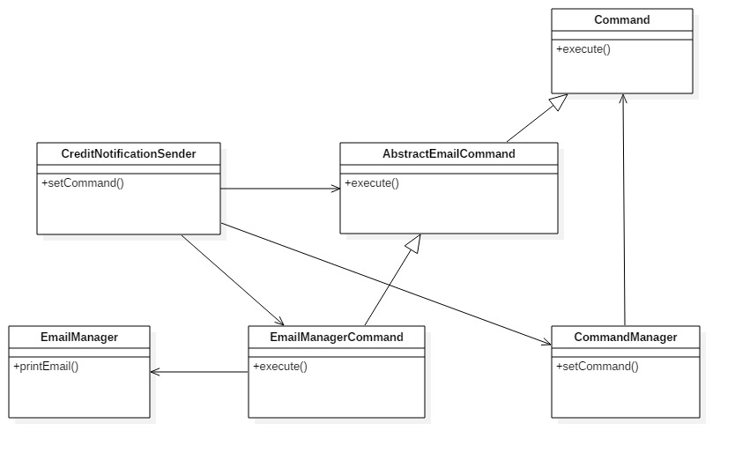
Design – Credit Notification Sender

Slide 9
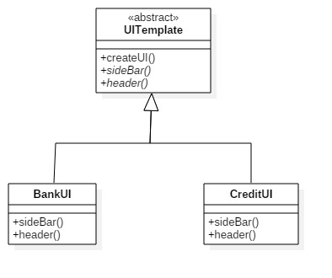
Design – UI Template Class Diagram

Slide 10
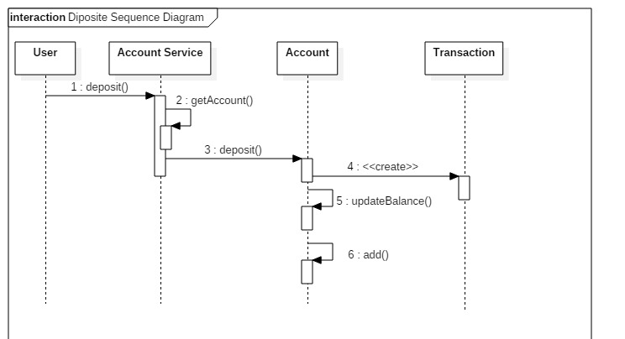
Design – Deposit Sequence Diagram

Slide 11
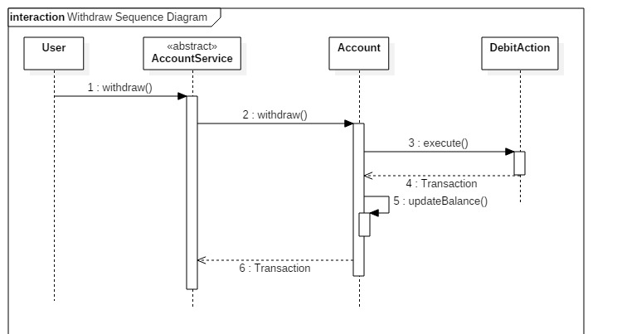
Design – Withdraw Sequence diagram

Slide 12
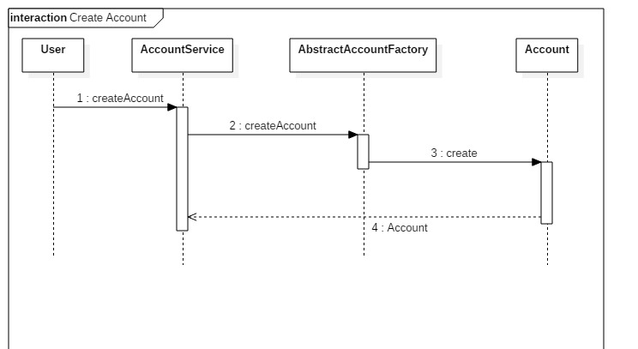
Design – Create account Sequence Diagram

Slide 13
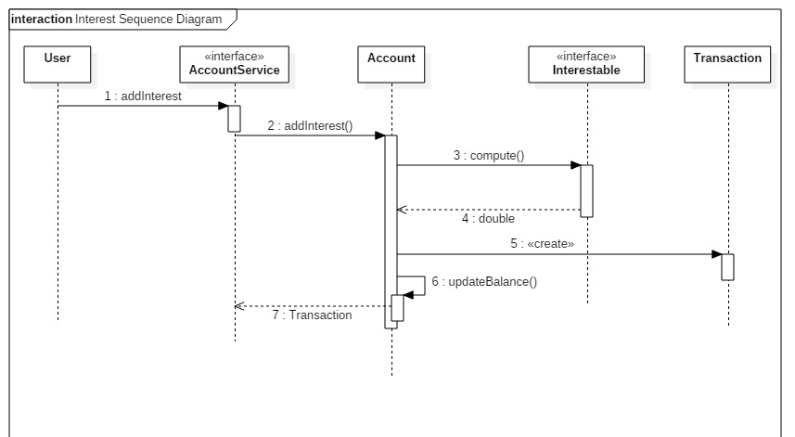
Design – Interest Sequence Diagram

Slide 14
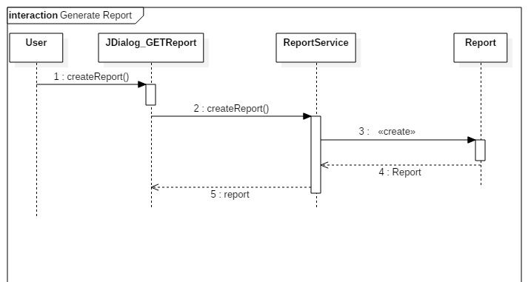
Design – Generate Report (banking)

Slide 15
Code and Demo

